Slide 1
Problem Definition
Problem space: mixing the power of graphical animation with education in order to provide a fun way to learn programming concepts.
Motivation and scope: approaching programming can a be hard task, especially for people who try to accomplish such a result on their own. My aim is to create a software that can explain key concepts in a simple and interactive way.

Slide 2
Software and Hardware
Programming language: Javascript, either NoSQL or SQL.
Software packages: Phaser.js, Angular 2+ (probably including Angular materials) and either MySQL or MongoDB.
Software environment: Node.js
Hardware platform and OS: I will develop my software using an HP Laptop dual-bootable with Windows 10 and Ubuntu.

Slide 3
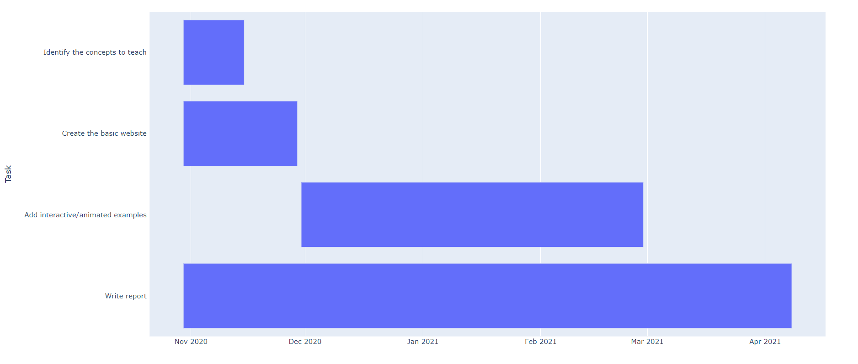
Planification

